Slide 1
Governance and Compliance
GRC Unit, Day 3

Slide 2

Class Objectives
By the end of today’s class, you will be able to:
Explain how organizations use policy and procedure to formalize standards of “right” and “wrong.”
Use governance frameworks to determine which policies an organization must develop.
Explain how audits are used to ensure compliance.
Develop business continuity and disaster recovery plans.

Slide 3
DAY 1
Structure of the security organization and the importance of security culture
DAY 2
Threat modeling and risk analysis
Notes:
11. Instructor Do: lesson plan pg. 32

Slide 4
Governance and Compliance
Today we will cover governance, compliance, and business continuity planning and disaster recovery (BCP/DR).
Codifying and enforcing proper behavior and operations. That is, establishing standards of “right” and “wrong,” and enforcing those standards.
Enforcing the policies in order to meet those standards.
Governance
Compliance

Slide 5

Knowledge of governance, compliance, and BCP/DR is crucial context for all security professionals. Most professional security work is mandated by governance policies and subject to compliance audits.
Notes:
Image source: shutterstock_664638928

Slide 6
Class Breakdown
Today’s class will cover the following topics:
01
Codifying Rules with Policy and Procedures
02
Using Governance Frameworks to Guide Policy Decisions
03
Audit and Compliance
04
Business Continuity Planning and Disaster Recovery (BCP/DR)
05
Developing BCP/DR Recommendations for an Organization

Slide 7
Codifying Rules with Policy and Procedures

Slide 8
REVIEW
We began this week by developing a training plan to improve GeldCorp’s security culture by changing employee behavior.
Notes:
11. Instructor Do: lesson plan pg. 32

Slide 9
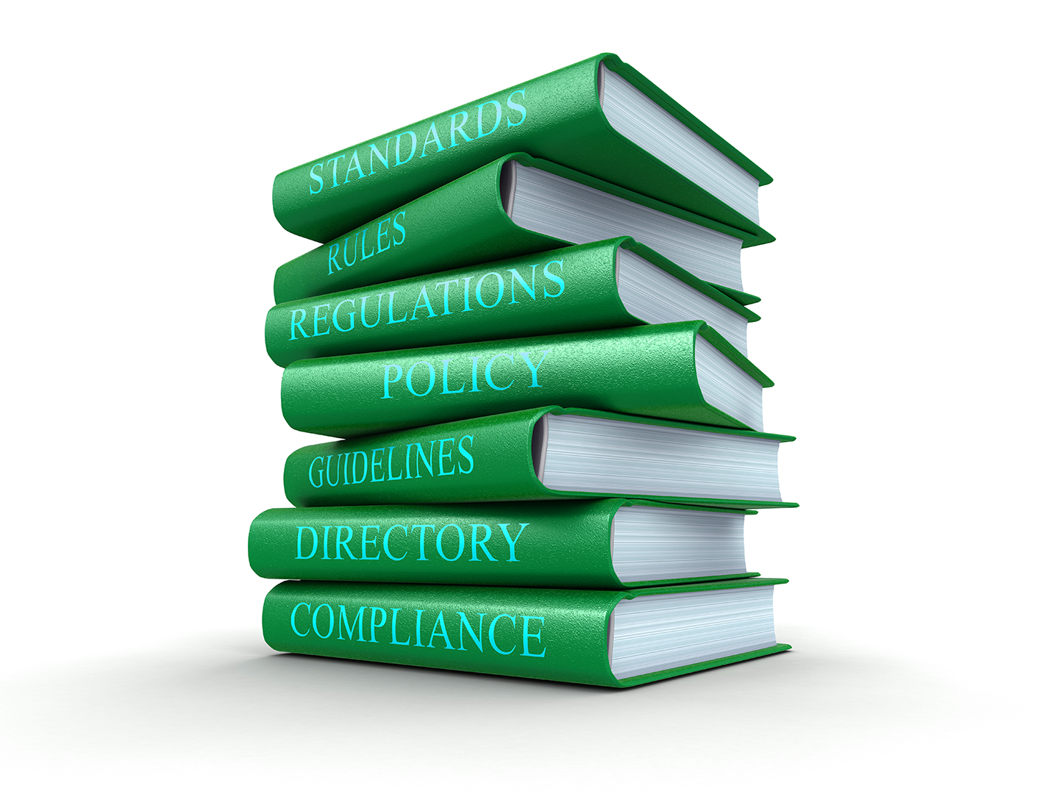
Policy and Framework
A policy is a rule that defines the “right” behavior.
Policies inform standards for behavior and operations.
A governance framework is a set of guidelines for the policies an organization should have in place.
Governance frameworks describe the guarantees that a company must provide in order to remain compliant with federal regulations and industry standards.
Notes:
Image source: shutterstock_328658639

Slide 10
Policy and Framework
Today, we’ll explore these concepts by:
Defining formal policies for the financial tech company GeldCorp.
Determining whether GeldCorp’s data collection practices are GDPR and PCI compliant.
Assessing what user data collected by GeldCorp is subject to General Data Protection Regulation (GDPR) and Payment Card Industry (PCI) Security Standard.

Slide 11
Using Organizational Goals to Define Policies
Remember: We developed training plans by setting goals and determining the steps necessary to achieve them.
The training plan prescribed a specific rule that employees should follow.
For example, “Do not click on links from emails outside of the corporate intranet.”
This rule is an example of a policy—a course or principle of action proposed by a business. In this case the rule specified a download policy.
The goal of defining and implementing a new download policy was to reduce employee click-through rate to less than 5%.
In other words, the business implemented a policy as a means of achieving a goal.

Slide 12
How Business Goals Drive Policy Implementation
Business goals often drives policy creation. The two main types of business goals are:
Internal/Volitional
External/Imposed
Targets that the business sets in its own interest.
For example, an organization might aim to reduce long-term security expenses to less than $400,000.
Targets that the business must hit because they will suffer consequences if they do not.
Examples include the requirement that online merchants process all credit card transactions securely, or suffer legal penalties if a customer’s PII is breached.
Business Goals

Slide 13
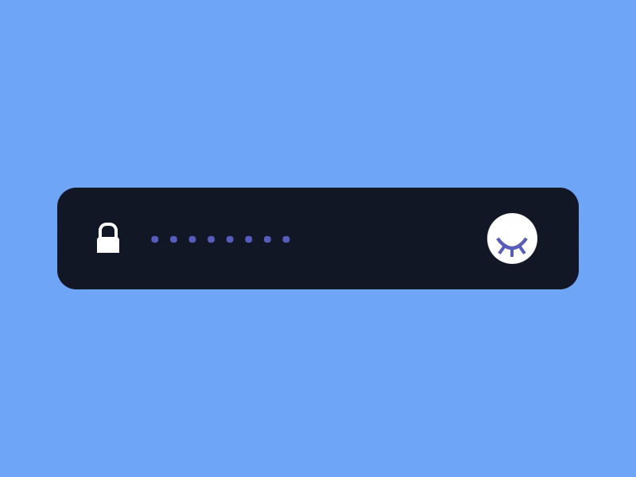
Internal Objectives and Policy: Example
Reduce unauthorized root-level login incidents on Domain Controllers to 0.
An organization would hand this off to the IT team, who would be responsible for determining how best to implement it.
One possible implementation is to require all domain administrators to use strong passwords, and force them to create a new password every month.
Notes:
Image source: Prekesh

Slide 14
Internal Objectives and Policy
Implementing a strong password policy might require that Administrators create passwords with:
At least 16 characters
At least 1 letter and 1 number
At least 1 special character (', (, ], etc.)
No portion of the administrator’s username
Required monthly updates

Slide 15

This policy defines clear standards of behavior.
Administrators must follow very specific rules with regard to their passwords. Their computers will also enforce these rules.
These rules are specifically designed to achieve the goal of reducing the incidence of unauthorized root-level logins on Domain Controllers to 0.
Notes:
Image Source: AdobeStock_101143687

Slide 16
Password Policy: Example Part 1
CONFIDENTIAL DOCUMENT
DATE: 5/17/2017
AUTHOR: Jane Author
DOMAIN ADMINISTRATOR PASSWORD POLICY
This document lays out a password policy for Domain Administrators.
PURPOSE
The purpose of implementing a Domain Administrator password policy is to reduce the incidence of unauthorized root-level logins on Domain Controllers.
The organization has prioritized this objective in the interest of protecting the integrity and confidentiality of data on the corporate intranet.

Slide 17
Password Policy: Example Part 2
CONFIDENTIAL DOCUMENT
POLICY DESCRIPTION
Domain Administrators will be required to create a new strong password every month. This password MUST NOT include any substring of the Domain Administrator's username.
In addition, the password must include:
- At least 16 Characters
- At least 1 Letter and 1 Number
- At least 1 Special Character (`'`, `(`, `]`, etc.)
For example, the following passwords are legal for the user `guest`:
- `CloGyPTioNEntEDist`
- `CloGyPTioNEntEDist`
- `n0tparticularly!strong`
The following password is illegal:
- `gue1st12345678901342`

Slide 18
Password Policy: Example Part 3
CONFIDENTIAL DOCUMENT
ENFORCEMENT
All workstations on the corporate domain have been configured to force Administrators to adhere to the above password complexity constraints and refresh intervals.
Non-compliant passwords will be rejected by the operating system.
MONITORING
All attempts to log in as a Domain Administrator—both remote and local—will be monitored.

Slide 19
Activity: Documenting Company Policies In the previous lesson, you performed a risk analysis to help GeldCorp understand its most prominent threats. They’ve since used your results to set a number of internal security goals.
In this activity, you will help them realize these goals by developing and documenting policies to support them.
15 minutes

Slide 21
Using Governance Frameworks
to Guide Policy Decisions

Slide 22
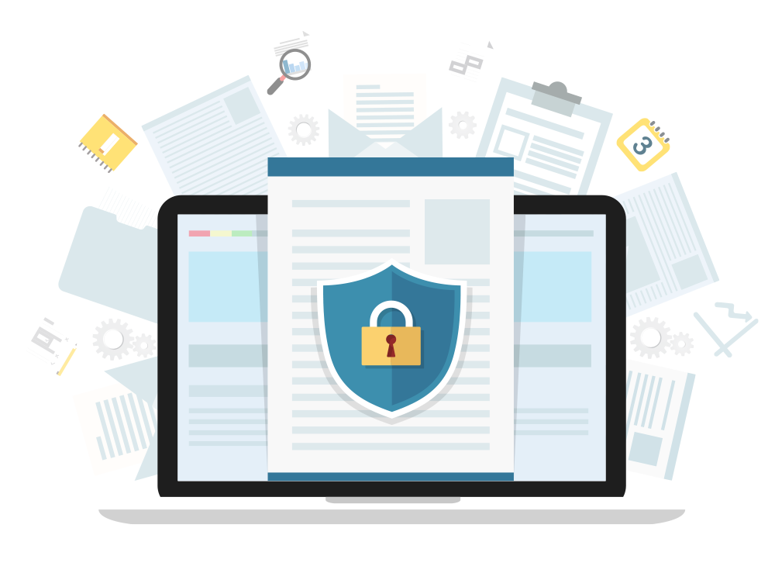
Internal Objectives and Policy
Businesses often have to follow external rules in addition to those they set for themselves. These rules don’t directly benefit the business, but might be mandated by law or industry standards.
Example: Merchants that process financial transactions are legally required to guarantee their customers’ data remains confidential. If a company suffers a breach resulting in the disclosure of customer PII, they may be fined and face other legal penalties.
Notes:
Image source: shutterstock_505694416

Slide 23

Governance Frameworks
There are some rules and policies that must be followed by everyone within an organization or industry. Collections of such policies are called governance frameworks. These can be:
Internal
Developed by the company.
External
Developed by standards bodies or governments.
Notes:
Image source: shutterstock_1330359209

Slide 24

SEC
Frameworks originate from the Securities and Exchange Commission (SEC), the regulatory organization in charge of proposing and enforcing laws regarding financial instruments (for example, stocks, bonds, options), and protecting consumers from fraud.
During the 1990s, the SEC worked with Congress to pass anti-fraud laws to discourage cybercrime.
In 2000, the SEC moved past simple anti-fraud laws by adopting the regulatory statute Regulation S-P.
Notes:
Image source: shutterstock_376748761

Slide 25

Rule 30 of Regulation S-P (Safeguard Rule)
Regulation S-P did not focus entirely on security, but Rule 30 mandated that organizations establish written policies and procedures designed to:
Insure the security and confidentiality of customer records and information.
Protect against any anticipated threats or hazards to the security or integrity of customer records and information.
Protect against unauthorized access to or use of customer records or information that could result in substantial harm or inconvenience to any customer.
Notes:
Image source: shutterstock_1330359557

Slide 26
SEC Regulations
Additional regulatory statutes and administrative milestones followed in subsequent years.
Regulation S-ID
Also known as the Identity Theft Red Flags Rule. Enforced “final rules and guidelines to require certain regulated entities to establish programs to address risks of identity theft.” The first regulation to formally require corporations to protect consumers’ Non-Public Information (NPI).
Regulation S-AM
Limits placed on when corporations can share consumers’ private information for advertising and marketing purposes.
2011
2014
2009
2013
Disclosure Guidance
Guidelines issued for when and how organizations should disclose breaches of cybersecurity. While not formal regulatory statutes with the force of law, these marked an important step towards cyber regulation.
Cybersecurity Regulation Blueprint
Cybersecurity recognized as an exam priority, meaning the SEC will review a firm's security posture as a routine part of their evaluations and audit standards.

Slide 27
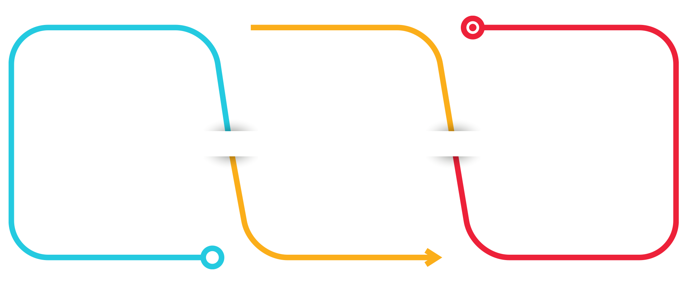
Common Governance Frameworks
All security professionals must be familiar with the following frameworks:
General Data Protection Regulation (GDPR)
protects the private data of all citizens of the EU and European Economic Area (EEA).
Health Insurance Portability and Accountability Act (HIPAA) mandates the protection of medical information.
Payment Card Industry Data Security Standard (PCI DSS) requires that companies handling credit card transactions do so securely.
Notes:
Image source: shutterstock_1135646558

Slide 28
Health Insurance Portability and Accountability Act (HIPAA)
Title II: HIPAA Administrative Specification is a provision establishing privacy standards around electronic access to healthcare data. Organizations must uphold the following standards to remain HIPAA compliant:
National Provider Identifier Standard: Requires all healthcare entities (people, healthcare providers, health plans, and employers) to have an ID, called the National Provider Identifier (NID).
Transactions and Code Set Standard: Standardizes health insurance claims.
HIPAA Privacy Rule: Standardizes protections for individually identifiable health information, such as prescription information and lab results. This defines what data to protect.
HIPAA Security Rule: Standardizes measures of patient data security. This defines how well data should be protected.
HIPAA Enforcement Rule: Provides guidelines for investigating non-compliant providers.

Slide 29
Activity: GDPR and PCI Compliance
In this activity, you’ll explore the GDPR and PCI compliance framework and determine which data managed by GeldCorp is subject to their regulations.
15 minutes

Slide 31
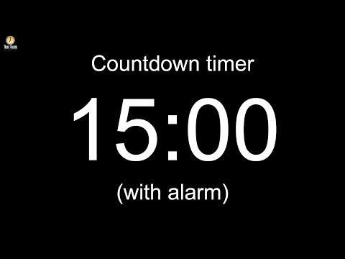
Notes:
Image source: AdobeStock_56885471

Slide 32
Audit and Compliance

Slide 33

Compliance and Audit
Businesses must enforce policies in order to guarantee compliance with regulations.
An audit is the process of checking how well an organization is adhering to its policies.
Audits are typically run to make sure an organization is upholding the statutes required by government frameworks.
Notes:
Image source: shutterstock_727498156

Slide 34

Performing an Audit
Auditors refer to each rule in the framework, and check that the business is following it.
If they find that the organization is in violation of a given mandate, they notify the Compliance/Legal and Executive teams in a final report.
In the event a business is found to be non-compliant in any way, the organization will typically respond by:
Acknowledging that they are aware of the non-compliance.
Determining a timeline to fix the issue.
Developing a plan to bring the organization back into compliance.
Notes:
Image source: Jerry Low

Slide 35
Activity: Audit Procedures
In this activity, you’ll review how GeldCorp collects and stores user data to ensure their processes are GDPR compliant. You’ll also identify any data that must be protected according to PCI standards.
Document any incidents of non-compliance so the organization can fix the issues.
10 minutes

Slide 36
Business Continuity Planning and Disaster Recovery (BCP/DR)

Slide 37

All the machinery of governance and compliance can’t guarantee that an organization will not experience a breach.
Businesses must still have contingency plans to prepare for the worst.
Notes:
Image source: Thinkmojo

Slide 38

Contingency Planning for Business Continuity
A breach can have one of two results:
Mild / Moderate Breach: The business has been impacted, but can still handle day-to-day operations at greater cost.
Serious / Catastrophic Breach: The business has been impacted so severely that they cannot operate.
Instead, they must use their resources to contain the incident, recover from the disaster, and eventually return to operation.
Notes:
Image source: shutterstock_1016735575

Slide 39

Contingency Planning for Business Continuity
Business continuity planning (BCP) and disaster recovery (DR) planning focus on contingency plans in the event of a disruption or disaster, and ensure that the business can resume daily operations.
What are some possible disruptions or disasters?
Cyber attacks
Human errors
Environmental disasters
Notes:
Image sources: shutterstock_411741793, shutterstock_185621111, shutterstock_511910884

Slide 40


Business Continuity Planning vs. Disaster Recovery
It is important to note the differences between BCP and DR.
Business Continuity Planning
Focuses on processes and procedures an organization must consider in order to ensure business critical functions continue during and after a disaster.
Disaster Recovery
Focuses on the specific steps an organization must take to resume work after a disaster.

Slide 41
Business Continuity Planning and Disaster Recovery
BCP and DR both begin with a contingency planning policy and business impact analysis.
Contingency planning focuses mainly on the availability of information systems, taking into account the impact of the company not having access to these systems.
Strategies for high-impact loss should consider high availability and redundancy options. For example, fully redundant load balanced systems at alternate sites, data mirroring, and offsite database replication.
High-availability options are normally expensive to set up, operate, and maintain and should be considered only for those high-impact information systems categorized with a high-availability security objective.
Lower-impact information systems may be able to use less expensive contingency options and tolerate longer downtimes for recovery or restoration of data.

Slide 42
NIST Impact levels
The following descriptions of impact levels originally appear in NISTs Contingency Planning Guide for Federal Information Systems.
Low
Moderate
High
The loss of confidentiality, integrity or availability could be expected to have a limited adverse effect on organizational operations, assets and individuals.
The loss of confidentiality, integrity or availability could be expected to have a serious adverse effect on organizational operations, assets and individuals.
The loss of confidentiality, integrity or availability could be expected to have a severe or catastrophic adverse effect on organizational operations, assets and individuals.

Slide 43

Contingency Planning
Contingency planning results in a contingency policy statement, which establishes the organization’s framework and responsibilities for maintaining confidentiality, integrity, and availability of data. It includes:
Responsibilities of an emergency response team
Resource requirements
Training requirements
Schedule for plan maintenance
Notes:
Image source: shutterstock_1007349100

Slide 44
Business Impact Analysis and Risk Assessment
A pivotal step in BCP and DR planning is the Business Impact Analysis and Risk Assessment. Goals include:
Identify key processes and functions of the business.
Establish a detailed list of requirements for business recovery.
Determine the resource requirements needed to resume key processes.
Evaluate impact on daily operations.
Develop priorities and classifications of business processes and functions.
Develop recovery time requirements.
Determine financial, operations, and legal impact of disruptions.

Slide 45
BIA Metrics
The results of the BIA impacts how the DR plan develops. In particular, it accounts for the following metrics:
Recovery Point Objective (RPO) represents the amount of data that a mission/business can afford to lose/recover (given the most recent backup copy of the data) after a disruption or system outage.
For example, if a company performs weekly backups, they can tolerate/recover from a week’s loss of data.
Maximum Tolerable Downtime (MTD) is the total amount of time a system can afford to be unavailable for users and the business.
Recovery Time Objective (RTO) is the maximum tolerable amount of time needed to bring all critical systems back online after a disaster has occured.
Work Recovery Time (WRT) is the time available to get the systems working again. WRT is the remainder of the MTD after the RTO. If MTD is four days and RTO is one day, WRT is three days.

Slide 46

BIA Metrics
MTD
RPO
RTO
WRT
Time
Stage 1 Business as usual
Stage 2 Disaster occurs
Stage 3 Recovery
Stage 4 Resume production
Source

Slide 47

Alternate Site
One last consideration for disaster recovery is the use of alternate sites to house critical data technology functions. While rare, disasters may require that these operations be moved to one an alternate sites.
A hot site is ready to go at all times. It has equipment loaded with currently available data and can immediately continue operations. It is costly, but important for mission- critical data.
A cold site has very little set up. It is typically not used until after a disaster, and needs a strategy for rapid setup.
A warm site is in-between. For example, servers, hardware, software, and other equipment might be setup but not loaded with the latest data.
Notes:
Image source: shutterstock_557774158

Slide 48
Activity: Disaster Recovery Planning
In this activity, you will continue to work in groups to create a high level disaster recovery plan for GeldCorp.
10 minutes

Slide 50
Placeholder
TBD

